Slide 1



Slide 2



Slide 3
INDEX
Slide 4 – About the project
Slide 5 – KPI 1
Slide 6 – KPI 2
Slide 7 to 12 – KPI 3
Slide 13 – KPI 4
Slide 14 – Excel Dashboard
Slide 15 – Power BI Dashboard
Slide 16- Tableau Dashboard
Slides 17 to 18 – SQL Dashboard
Slides 19 to 20 – Challenges Faced
Slide 21 – Conclusion
Slide 22 - Summary

Slide 4
Insights from Flights Data
Introduction to the Project
Project Context: Brief explanation about analyzing different routes of US Airlines flying through various cities, states, and airports for the year 2015.
Objective: The main goals of the analysis, include extracting meaningful insights from the data through the defined KPIs.
Impact: We are discussing the impact of flight delays and flights canceled and how it affects the operations of various airlines.

Slide 5
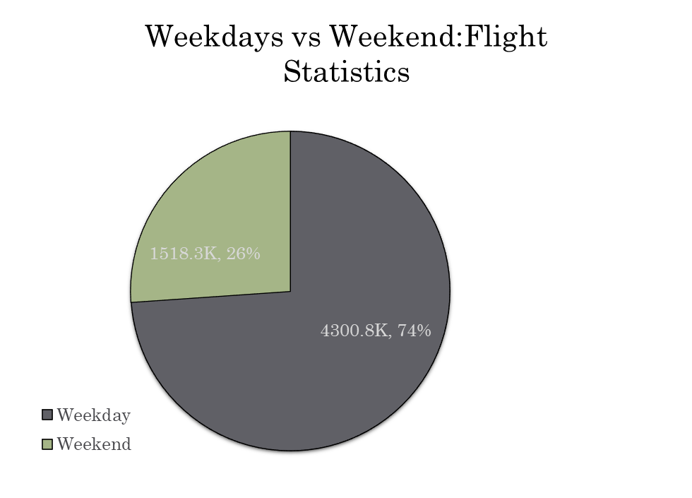
KPI1 -Weekday vs Weekend: Total Flight Statistics
We can see that 4300k flights operate on Weekdays (74%) whereas 1518k flights operate on Weekends(26%)
So from data we can say that 3/4th flights operate on weekdays whereas 1/4th flights operate on weekends
So more people prefer to fly on weekdays rather than weekends reason might be people prefer to travel for work, business purpose on weekdays.
My suggestion is we must increase the flights on weekends so more people can travel on weekends.

Slide 6
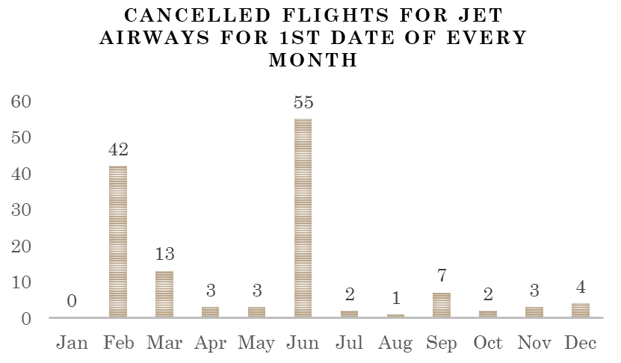
KPI 2 - Total number of canceled flights for JetBlue Airways on the first date of every month
We can see that the most number of cancelled flights are on 1st June (55) followed by 1st Feb (42) followed by 1st Mar(13).
We can see that Jan has the least number of cancelled flights(0) followed by Aug(1).
So the suggestion is Jet Airways must try to reduce cancelled flights on 1st June and 1st Feb

Slide 7
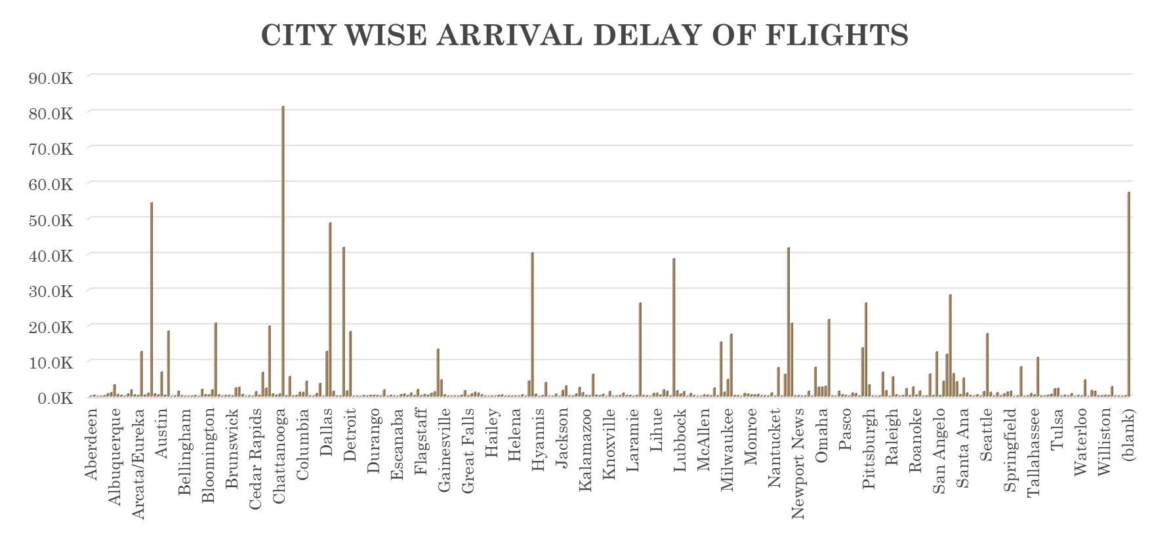
KPI 3 - City Wise Delay of Flights

Slide 8
City Wise Delay of Flights
From the graph, we can see that Chicago has the highest number of arrival delays (81,3k) followed by Atlanta(54,3k) and Dallas (48,7k)
The lowest number of arrival delays are from Dillingham, Hyannis, and Ithaca(0 k)
As Atlanta, Chicago, and Dallas have the highest count of flights operating (346.8k,366.8k,239.6k) the number of arrival delays in these cities is higher compared to the other cities
The cities of Dillingham, Hyannis, and Ithaca have the lowest count of flights so arrival delays are also relatively low.
So cities of Chicago, Atlanta, and Dallas must make sure that flights arrive on time without any delay. The arrival delay of these cities can be reduced.

Slide 9
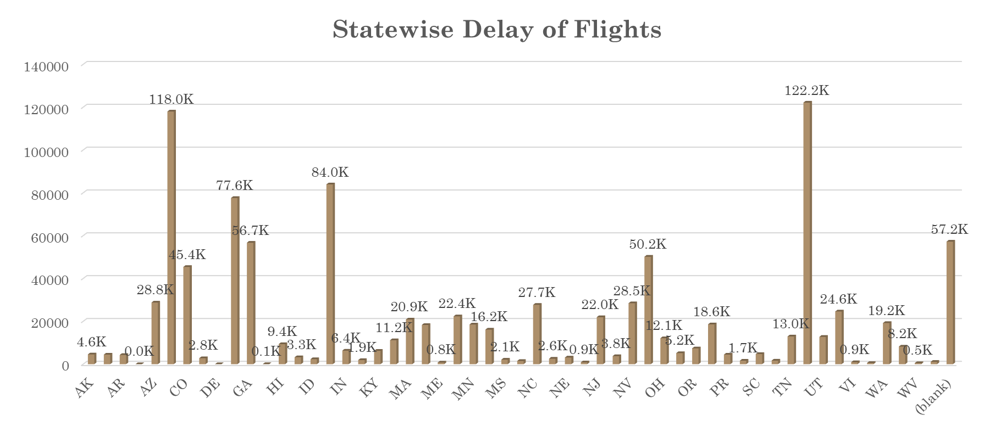
KPI 3 - State wise Delay of Flights

Slide 10
State wise Delay of Flights
From the graph we can say that the states of TX, CA and IL have the highest delay of flights with values of 122k,118k, and 84k respectively
We can see that the states of AS, DE, and GU have the lowest delay of flights with values of 31,37 and 55 respectively.
The states of TX,CA, and IL have the highest arrival delays as these states have the highest count of flights among all the states(631.1k,647.9k, and 381k respectively)
The states of AS, DE, and GU have the lowest delay of flights as these states have the lowest count of flights among all the states.(0.1k,0.1k,0.3k)
Suggestion is these states must reduce their arrival delay to improve their efficiency.

Slide 11
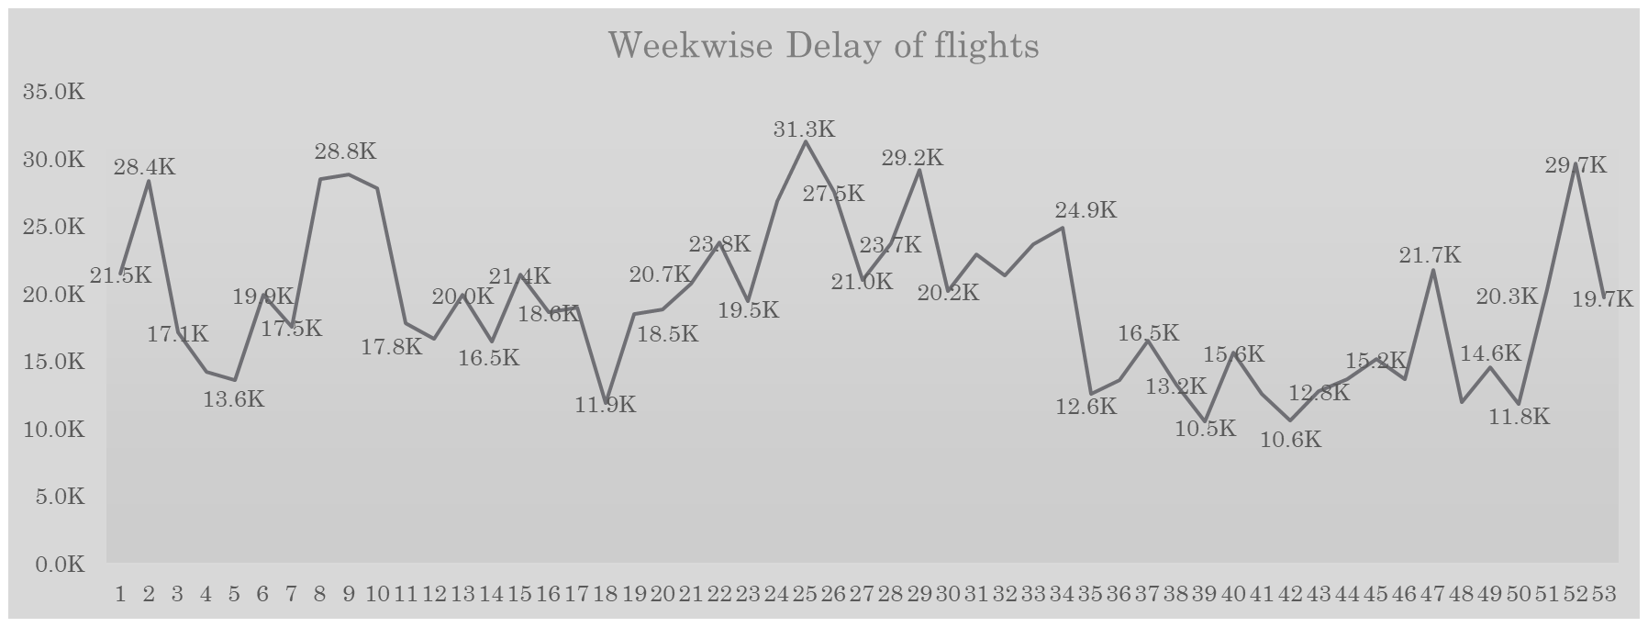
KPI 3- Week wise Delay of Flights

Slide 12
Weekwise Delay of Flights
We can see that Week 25 has the highest arrival delays with 31.3k followed by Week 52 (29.7k) and Week 29 (29.2k)
We can see that Week 39, Week 42, and Week 50 have the lowest arrival delays with values of 10.5k,10.6k, and 11.8k respectively.
Suggestion is that Week 25, Week 52 and Week 29 must try to reduce their arrival delay to the levels of Week 39,42 and 50.
The arrival delays could be because of any Air System Delay, Security Delay, Airline Delay, Late Aircraft Delay, and Weather Delay or it could be more than one reason. Those reasons must be identified and the arrival delay count can be reduced.

Slide 13
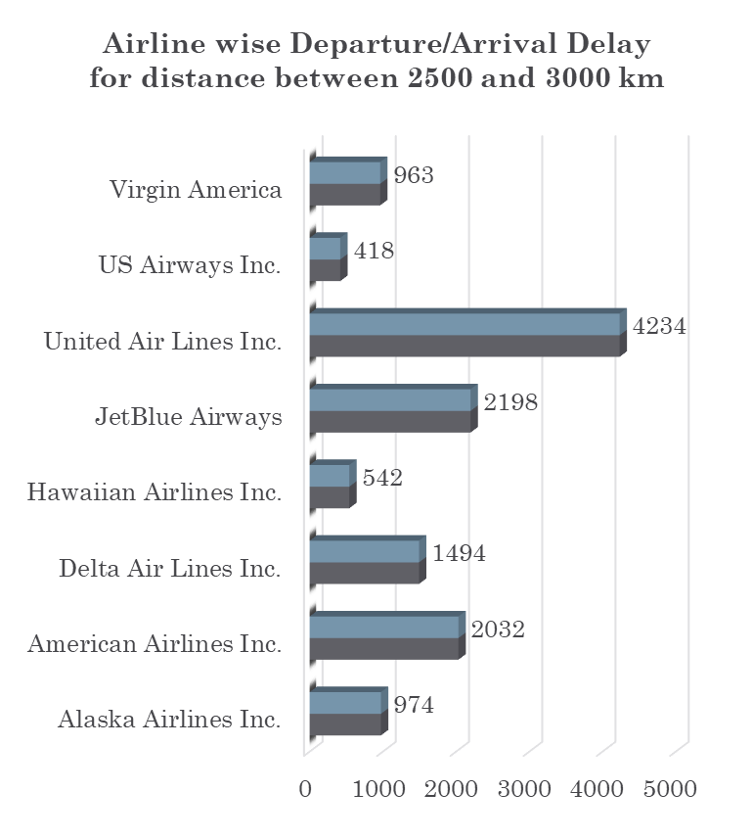
KPI 4 - Number of airlines with departure/arrival delay with distance covered between 2500 and 3000
We can see that United Airlines has the highest number of Departure/Arrival Delay of 4234 followed by Jet Blue Airways of 2198.
Hawaiian Airlines has the lowest number of Departure/Arrival Delay of 543 followed by Virgin America 963.
It is observed that Frontier Airlines, Sky West Airlines, Spirit Airlines, Southwest Airlines, Atlantic Southeast Airlines, and American Eagle Airlines have no arrival/departure delay between 2500 to 3000 kms.
United Airlines and Jet Blue Airways have the highest count of flights between 2500 to 3000 km hence the number of delays is highest for them.
Similarly US Airways and Hawaiian Airlines have the lowest count of flights hence they have the lowest delay of flights between 2500 to 3000 km.
Suggestion is these airlines must find out why they are having departure/arrival delays, it could be among air system delays, security delays, airline delays, late aircraft delays, and weather delays and identify and reduce the delay.

Slide 14
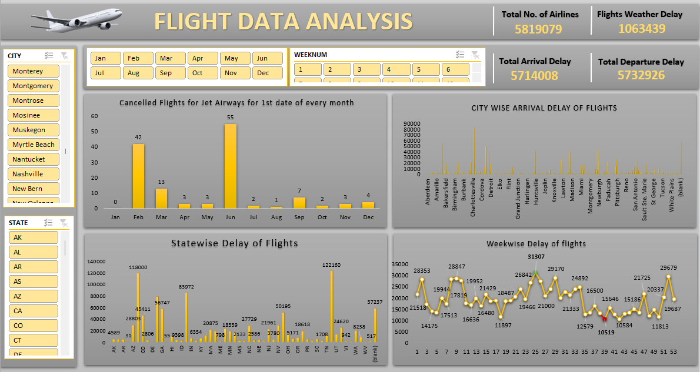
Excel Dashboard

Slide 15
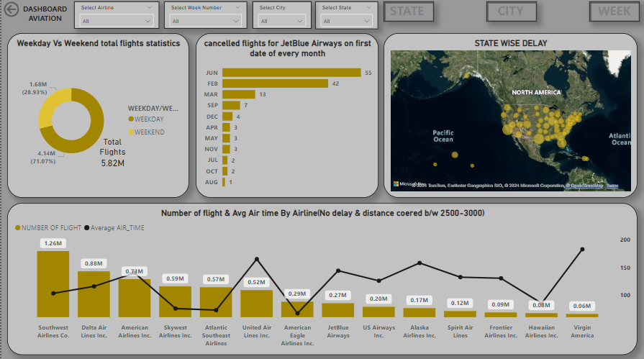
Power BI Dashboard

Slide 16
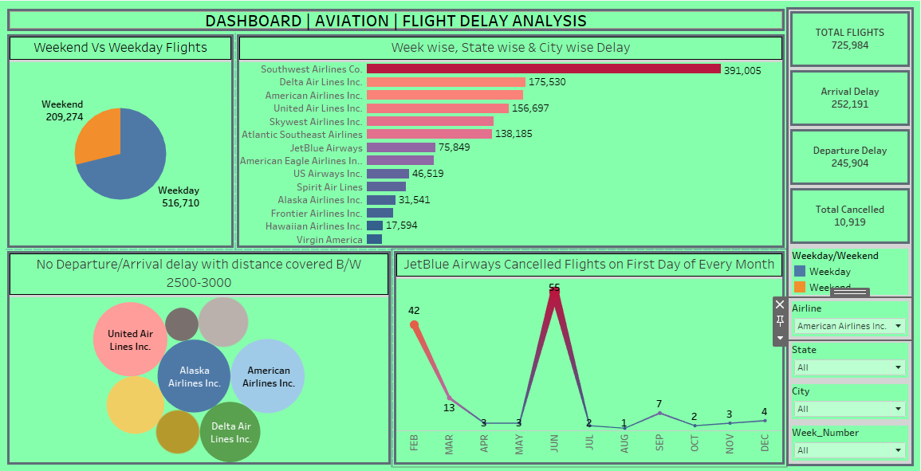
Tableau Dashboard

Slide 17
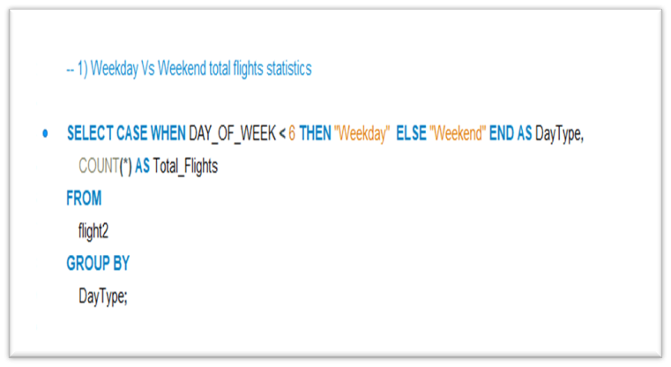
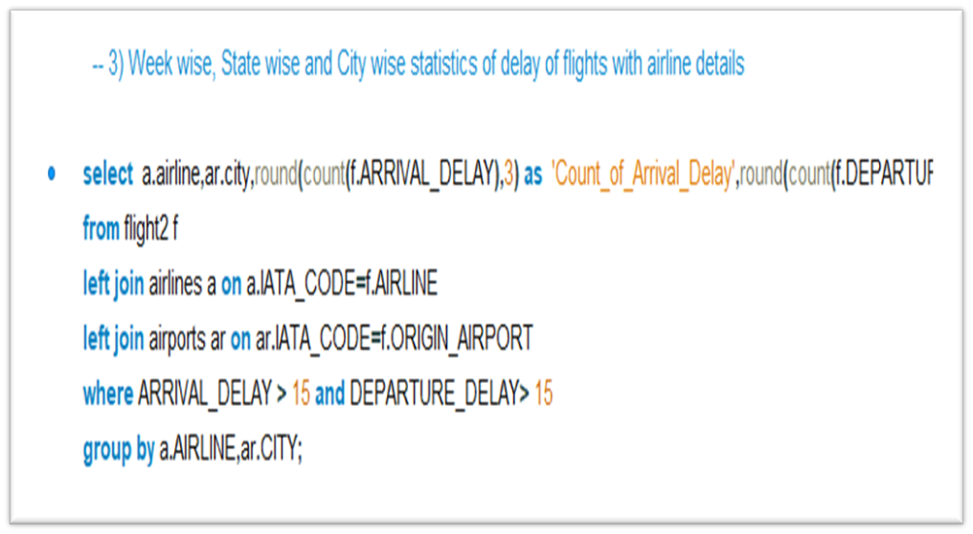
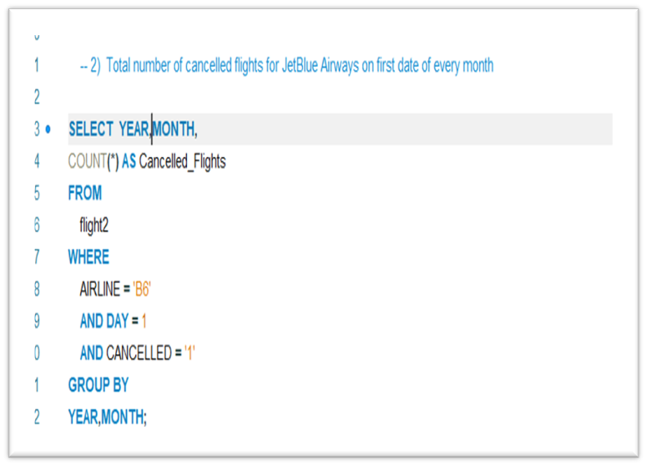
SQL Queries
KPI 1
KPI 2
KPI 3
Weekday vs Weekend Flight Statistics
Total number of canceled flights for JetBlue Airways on the first date of every month
City Wise Delay of Flights

Slide 18
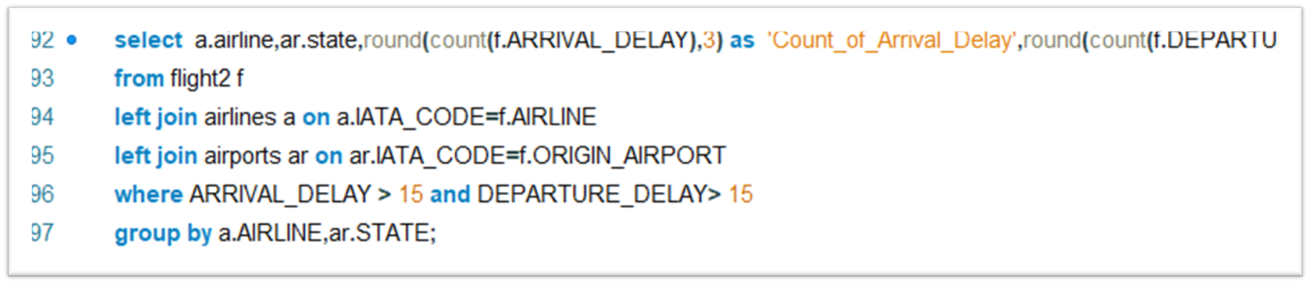
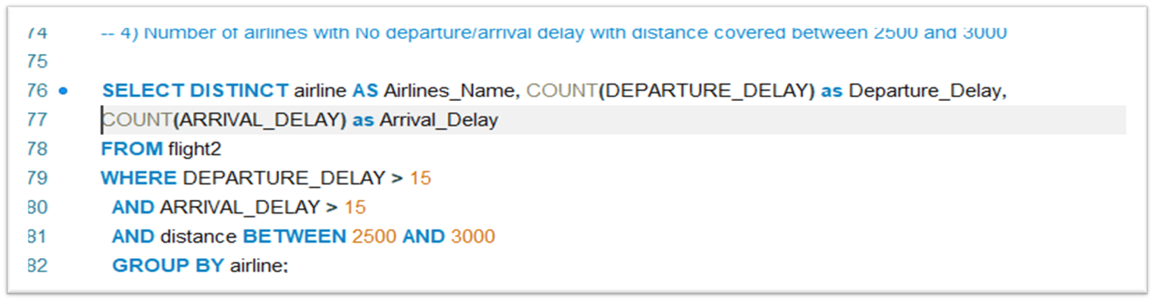
SQL Queries
KPI 3 State Wise Delay of Flights
KPI 4 Number of airlines with No departure/arrival delay with distance covered between 2500 and 3000

Slide 19
Challenges Faced
Excel:
The challenge faced in Excel is loading 58 Lakh rows of data into Excel.
Excel has a maximum limit of 10 Lakh rows per sheet so it was difficult to load 58 Lakh rows into Excel. As a result, we were getting inaccurate results. So we loaded the data from all 3 sheets (airports, airlines, flights ) through Power Query into Excel.
We loaded the data from airports and airlines directly to excel, whereas for the flight’s sheet, we loaded the data directly from CSV to Power Pivot as it has 58 Lakh rows. We were successful in loading 58 Lakh rows and also saving memory and space.

Slide 20
Challenges Faced
SQL:
The challenge we faced in SQL is loading 58 Lakh rows into SQL. From the flight file, we could load only 10 Lakh rows.
The dataset being huge we did not use Import Wizard but we used “LOAD DATA INFILE”.
We used UTF-8 characters for the rows while importing data from CSV files.
We used the following technique (@YEAR, SET YEAR = IF(@YEAR = '', NULL, @YEAR) while importing data. Thus we imported 58 Lakh rows into SQL Workbench

Slide 21
Conclusion
We can see that most of the flights operate on Weekdays (74%) whereas only 26% of flights operate on Weekends.
Jet Blue Airways had the most number of canceled flights on 1st June(55) followed by 1st Feb (42)
Among all cities Chicago, Atlanta, and Dallas have the highest arrival delays, these cities have the highest count of flights among all cities involved So higher the count of flights higher the chances of arrival delay
Among all states TX, CA, and IL have the highest arrival delays, these states have the highest count of flights among all states involved we can see that there is a direct proportion between the count of flights and the count of arrival delays
Week wise week 25 has the highest arrival delays followed by week 52 and week 29
United Airlines, Jet Blue Airways, and American Airlines have the highest departure/arrival delays for distances between 2500 to 3000 km

Slide 22
Summary
We played a key role in conducting flight delay analysis for the aviation industry in the US for the year 2015, ensuring proper decision-making. We have analyzed 58 Lakh rows of data By analyzing the aviation industry data, we have categorized flight data based on weekday, weekend, month, week number, city, state, and distance. Our exploratory data analysis revealed cancellation of flights, departure delay, arrival delay, air time, and distance traveled by various airlines over different cities, and state sizes over the entire time period of 2015. We could analyze the flight delays of various airlines and tell which airlines are performing well and which airlines need to improve their performance. Leveraging SQL, Excel, Power BI, and Tableau we investigated aviation industry data to assess the performance of flights of different airlines flying through various cities, states, and different days, weeks, and months. Furthermore, we developed and maintained data visualization dashboards to efficiently track key metrics, enhancing business insights.

Slide 23


